Slide 1
Operation of Router
袁华：hyuan@scut.edu.cn
School of Computer Science & Engineering ,SCUT
Communication & Computer Network key-Lab of GD

Slide 2
Outline
Learn router and its running
Master the use of hyper terminal
Master user mode and Privileged mode
To use commands: help ,history
Master basic configurations of router
Master routing configuration

Slide 3
Components of router
Router: is a computer with strong functions.
  RAM/DRAM （routing table）
  NVRAM （backup configure-file）
  Flash M （IOS）
  ROM （bootstrp，kernel of IOS）
  Interface
  Others: e.g. : CPU

Slide 4
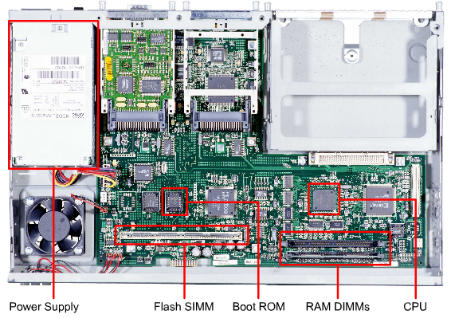

Slide 5
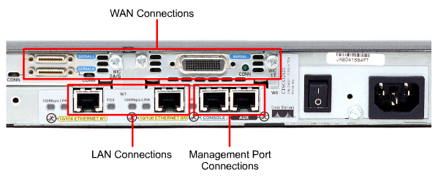
Interfaces

Slide 6
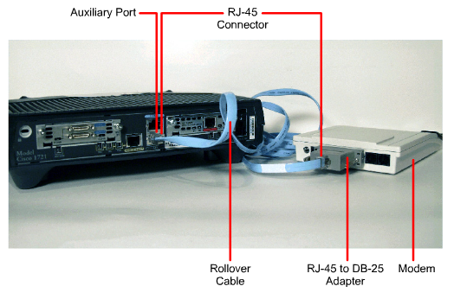
How to connect?

Slide 7
How to run a router?
Power on, self check, e.g. hardware
Bootp from ROM
Look up IOS（配置寄存器的bootfield字段）
Loading IOS
Loading configure files and run line bye line
If there is no configure file，the router will enter setup dialog

Slide 8
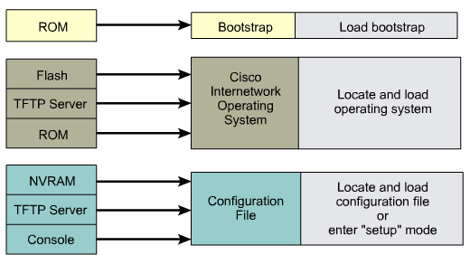
Pay attention

Slide 9
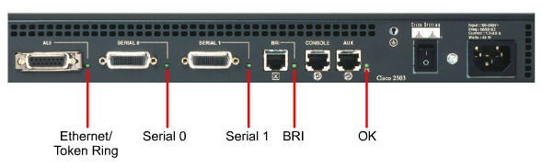
Pay attention: indicator light

Slide 10
Setup dialog
Setup dialog
  System setup dialog
  Default answer
  you can enter the dialog if you enter “setup” in global configure mode
Basic global parameters
  The name of rotuer（hostname）
  passwords

Slide 11
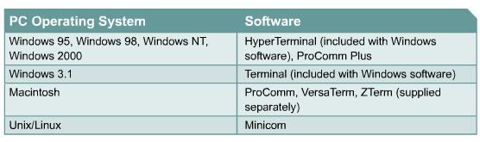
Session between a computer and a router
Hyper terminal
Connect use console wire
Set parameters

Slide 12
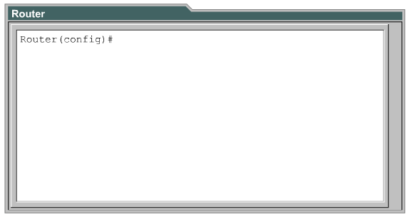
User interface of router
CLI，command line interface

Slide 13
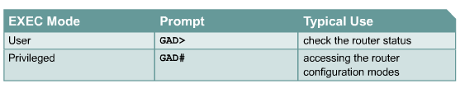
User interface of router（cont’d）
User mode
  Just view the state of a router
Privileged mode
  Can configure or modify the configuration

Slide 14
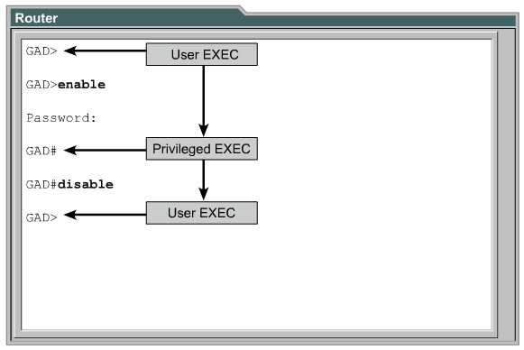
Switch between user and privileged

Slide 15
From privileged mode， you can。。。
Configure terminal
interface
subinterface
line
router
route-map
退回用户模式：disable
注销：exit

Slide 16
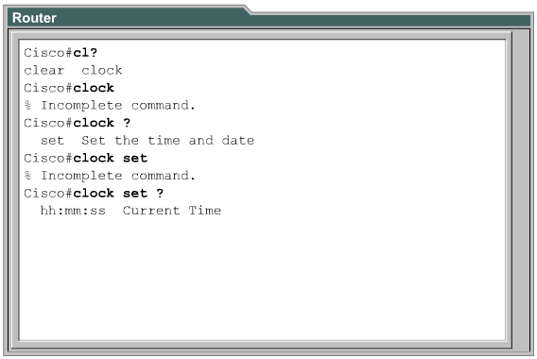
Command help：？

Slide 17
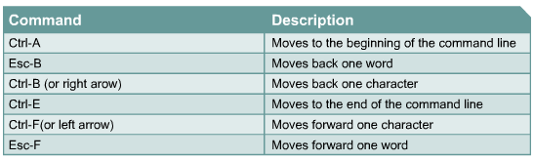
Strong editing
You can stop the function：in priviledged mode，enter: terminal no editing

Slide 18
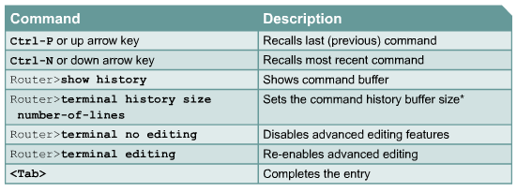
Command about “history”
In default situation, the history function opens ,and default value of history commands is 10。
To use terminal history size and history size to set the value，maximum is 256

Slide 19
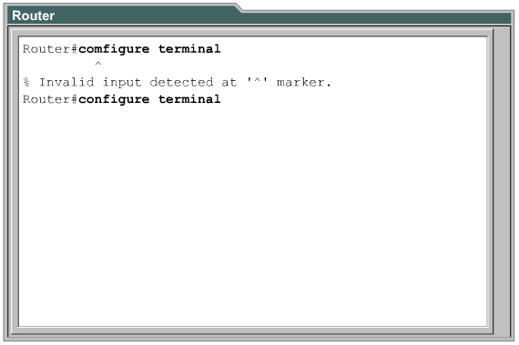
Indicators about wrong command

Slide 20
Check the state of router
IOS version
Configuration register
NVRAM
FLASH
Interfaces

Slide 21
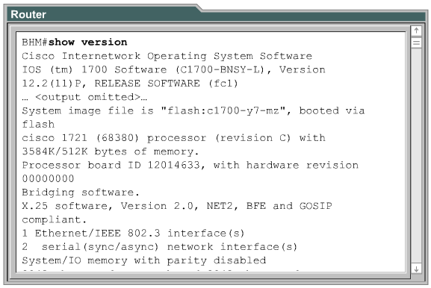
Show version

Slide 22
The basic configuration
The name
Passwords
SHOW command
To configure interfaces
Routing configuration
Modify

Slide 23
Configure the name of a router
Enter the configuration mode
  In privileged mode，enter：
    Configure terminal（conf t）
Router(config)#hostname scut
scut(config)#

Slide 24
Configure password
The types of password
  Console（控制台口令）
  telnet（远程登录口令）
  Enable（使能口令）
Secret or not
  Secret password，can not be get it again if it is forgot
  Normal password，visible in configuration

Slide 25
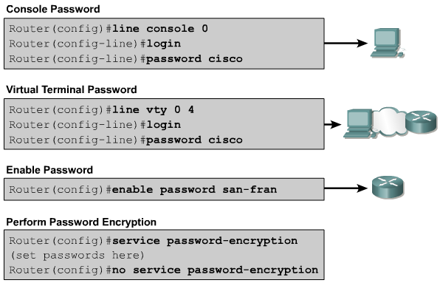
Configure password

Slide 26
Configure serial interfaces
Router(config)#interface serial 0/0
Router(config-if)#ip address <ip address> <netmask>
Router(config)#interface serial 0/0
Router(config-if)#clock rate 56000
Router(config-if)#no shutdown

Slide 27
Configure Ethernet interface
Router(config)#interface e0
Router(config-if)#ip address 192.168.0.1 255.255.255.0
Router(config-if)#no shutdown
Pay attention: must use no shutdown to run the interface

Slide 28
Modify the configuration
no ：single command
Reload the router
  Reload the configuration files
Delete configuration files
  erease startup-configuration
  Reload
  Setup dialog

Slide 29
Routing：static routing
Make sure the destination network (address and mask) and nexthop (or local interface)
Enter the global configuration mode
Use command ip route
Exit the global configuration mode
Save the configuration
  copy running-config startup-config

Slide 30
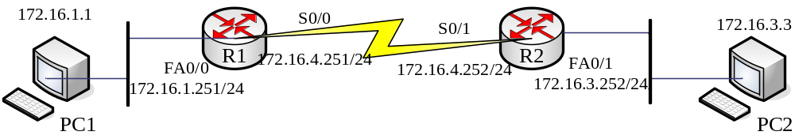
Configure the static routing
Ip route prefix mask {address|interface} [distance]
R1(config)＃ip route 172.16.3.0 255.255.255.0 serial0/0
Show ip route
Pay attention：suitable for Point to Point

Slide 31
Another configuration
R1(config)＃ip route 172.16.3.0 255.255.255.0 172.16.4.252
Show ip route
Pay attention：suitable all networks

Slide 32
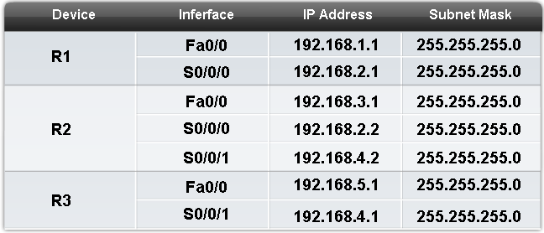
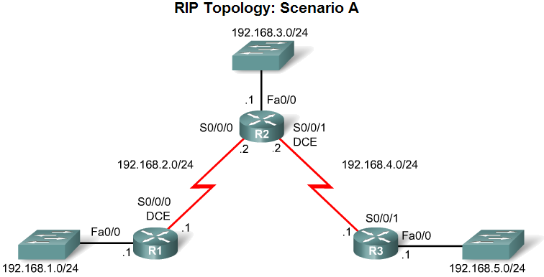
Routing configure：RIP
Suitable for RIPv1:
  Use five C

Slide 33
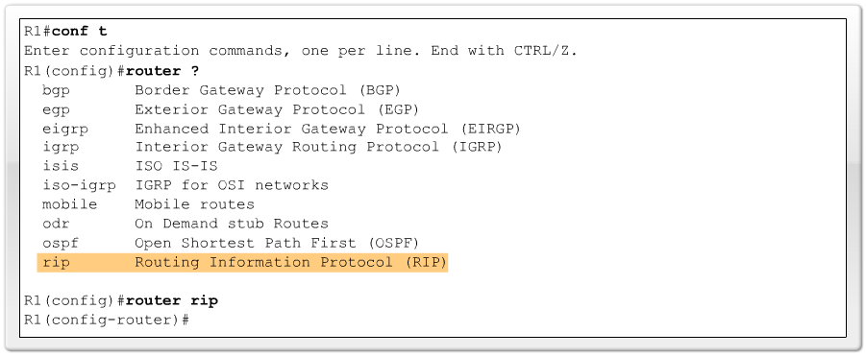
Run RIP: router rip
Run RIP :
-Router rip (global configuration mode) -indicator: R1(config-router)#

Slide 34
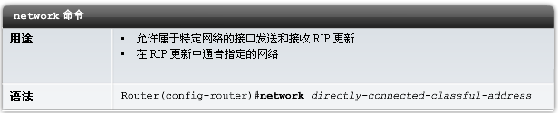
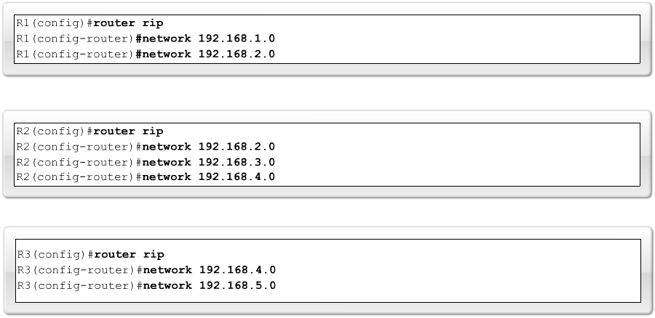
Network command

Slide 35
Routing configure ：OSPF
Router(config)#router ospf process-id
  Range: 1～65535
Router(config-router)#network address wild-mask area area-id
  Designate the component of OSPF area

Slide 36
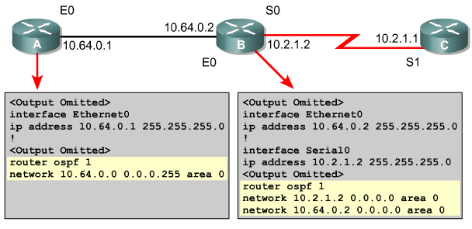
Routing configure ：OSPF

Slide 37
Command Show
show interfaces – Displays all the statistics for all the interfaces on the router. To view the statistics for a specific interface, enter the show interfaces command followed by the specific interface and port number. For example: Router#show interfaces serial 0/1
show controllers serial – Displays information-specific to the interface hardware
show clock – Shows the time set in the router
show hosts – Displays a cached list of host names and addresses
show users – Displays all users who are connected to the router
show history – Displays a history of commands that have been entered
show flash – Displays information about flash memory and what IOS files are stored there
show version – Displays information about the router and the IOS that is running in RAM
show ARP – Displays the ARP table of the router
show protocol – Displays the global and interface specific status of any configured Layer 3 protocols
show startup-configuration – Displays the saved configuration located in NVRAM
show running-configuration – Displays the configuration currently running in RAM

Slide 38
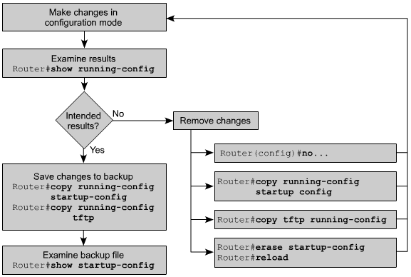
How to modify the configuration?

Slide 39
To finish the configuring
Setup a standard
  To describe the interfaces
  To setup login banner
  Hostname
Backup the configuration

Slide 40
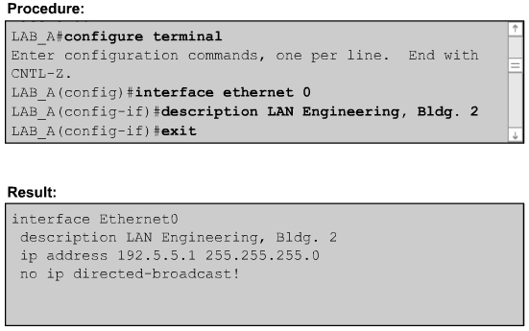
Description of interfaces

Slide 41

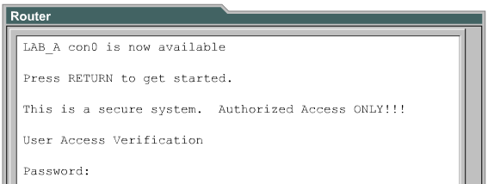
Login banner

Slide 42
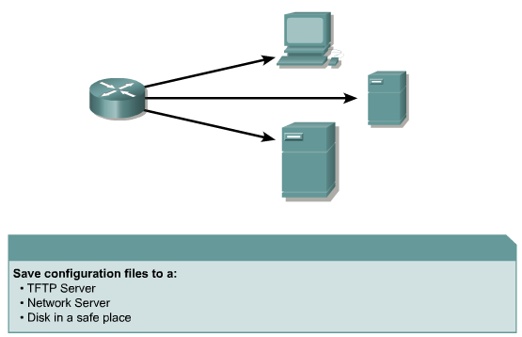
Backup of the configuration
Router# copy running-config tftp
Router# copy tftp running-config

Slide 43
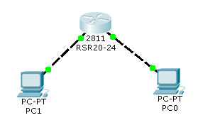
Experiment 3 （finished by yourself）
Discover
Show
  Version、running-config、startup-config、ip route
Configure
  hostname
  ip address
IPv6 is optional

Slide 44
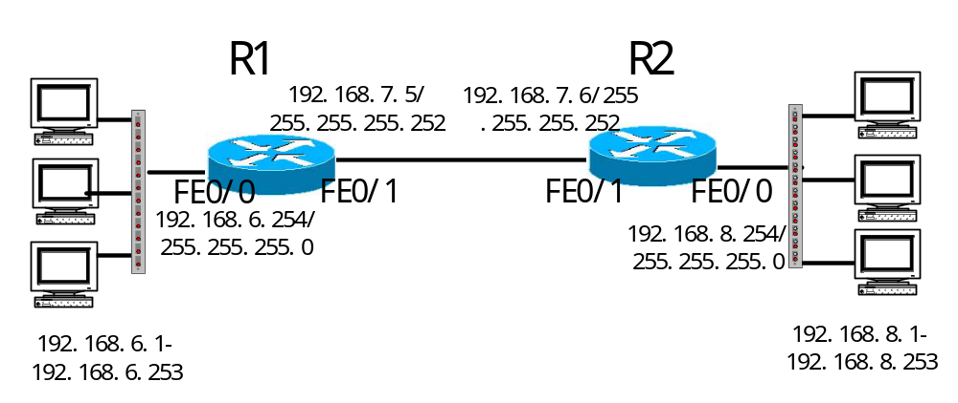
Experiment 4 （4 persons）
Group：4
Group leader：draw topology，Coordinate，submit the report（only one）

Slide 45
Pay attention
Based on CISCO command
There are some differences among the commands of different manufacturer.
  The manufacturer are Ruijie in B3-230 and B3-231
Please use “?” whenever you don’t learn how to use the command

Slide 46
Pay attention
A PC have 2 NICs
  One is Consel （used to control routers and switches ）
  Another is “verify” （used in experimental topology ）
IP address of “verify” NICs is allocated by youself, don’t use IP address whose subnet is same as consel NICs’ !

Slide 47

Do It Yourself！ thanks！

